Slide 1

New Member Orientation
Brendon Hatcher
All links and sources are in the slide notes
V3 – 06/10/2026

Slide 2
Introduction
Me – member for 7 years, lasertech, open days, courses
Goals – help you use the space and online resources as quickly as possible
Resources – this presentation, with links in the slide notes
Login to discourse if you want to follow with me

Slide 3
Understanding SLMS

Slide 4
Member-run organisation
Access
  No “business hours”
  No “staff on site”
Tool maintenance & repair
  Done when someone is available to do it
Restrictions on commercial use
  Due to constraints above and shared access to tools
  Prototyping is welcome

Slide 5
Member-run organisation
Volunteering
  Encouraged
  Opportunities posted on Discourse
Cleaning and tidying
  Essential that you clean and tidy your work area and return tools to original location
  Deep clean done weekly
  NO FOOD WASTE outside of the food waste bins – rats!!!

Slide 6
Governance
Non-profit company limited by guarantee
3 directors
  Legal and financial operation
Other roles
  Secretary
  Treasurer
  Systems
  Welcome & membership management
  Marketing and events
  Discourse moderators
Techs
  Delegated responsibility for specific spaces and tools

Slide 7
Participation
Meetups
  Electronics, bike repair, metalshop etc
Member meetings
  Discussions and voting
Discourse at the heart of it all
  Notifications – tools offline, changes to procedures etc
  Discussions – projects, operations, issues

Slide 8
Volunteering
Become a tech
Become an inductor
Cleanups, repairs, commissioning
Host open evening tours
Be a MakerBuddy
Ask techs before doing something that they didn’t request

Slide 9
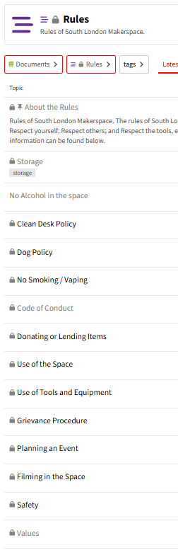
Rules
Published on Discourse
  Code of conduct
  Alcohol, drugs and vaping not permitted in the space
  Clean desk policy
  Storage policy
  Dog policy
  Etc
Notes:
https://discourse.southlondonmakerspace.org/c/documents/rules/11

Slide 10
First steps

Slide 11
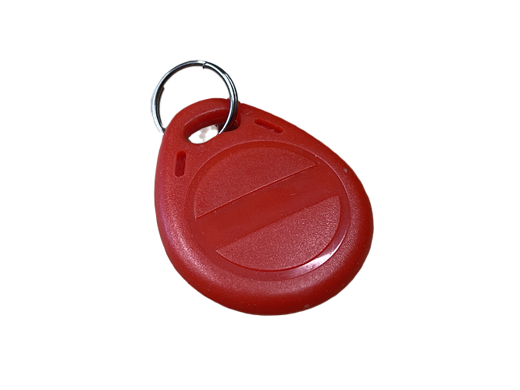
First steps after membership activation
Fetch and activate a fob
Introduction – start finding like-minded people
Read the “How To” docs – cover more detail than this orientation does
Explore the space and tools
Add yourself to induction waiting lists
Notes:
https://discourse.southlondonmakerspace.org/t/membership-system-guide-enrolling-a-tag/8591
https://discourse.southlondonmakerspace.org/c/introductions
https://discourse.southlondonmakerspace.org/c/documents/how-to/64

Slide 12
Discourse

Slide 13
What’s on Discourse
Discussions
Private messaging between members
Induction waiting lists and invitations
Documents
Calendar
Tool bookings

Slide 14
Accessing Discourse
A mix of public and member-only access
The website version provides the best browsing and editing experience
Mobile app
  Editing is trickier - must repeatedly close the keyboard to navigate around the screen
  Do not install from the app store – see slide notes for installation instructions
  Default screen is not the most useful – see slide notes on how to change it
Notes:
https://discourse.southlondonmakerspace.org/
Installation:
Open the discourse site in your mobile browser
2. Start the install
iOS - Share / Add to Home screen
Android - 3-dot button / Install app
Change the default screen:
Profile icon
Profile button
Preferences
Interface
Default home page = Latest

Slide 15
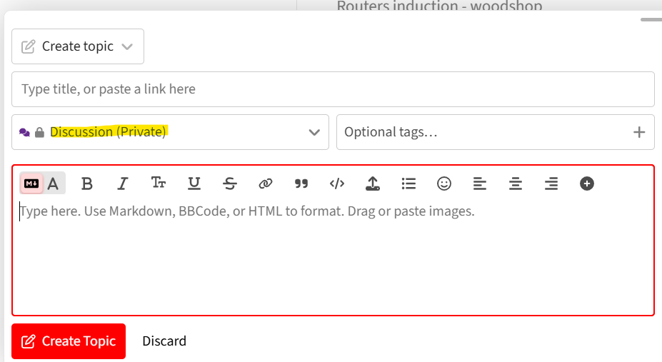
Posting on Discourse
Go to Topics
New topic
Title
Choose category – note “Discussion (Private)” for posts that should not been seen by Google and non-member Discourse users
Type the post
Format using the editor buttons and/or Markup

Slide 16
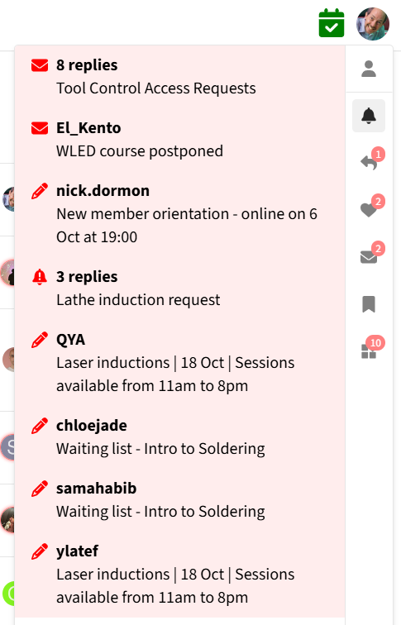
Staying informed
Email notifications
  Digest
  Responses to your posts – likes and replies
  Topics you are following
  Posts in which you are tagged
  Personal messages
  Context sometimes lost / difficult to understand
In-app notifications
Notes:
https://discourse.southlondonmakerspace.org/

Slide 17
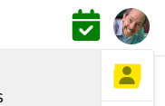
Managing notifications
Profile icon
Profile button twice
Preferences
  Emails
  Notifications
  Tracking
Notes:
https://discourse.southlondonmakerspace.org/

Slide 18
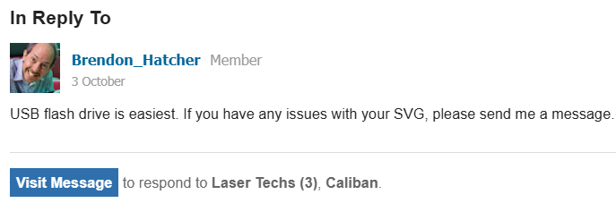
Email replies
You can’t respond to an email notification by replying to the email
Follow the link back to Discourse to reply

Slide 19
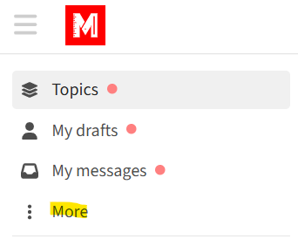
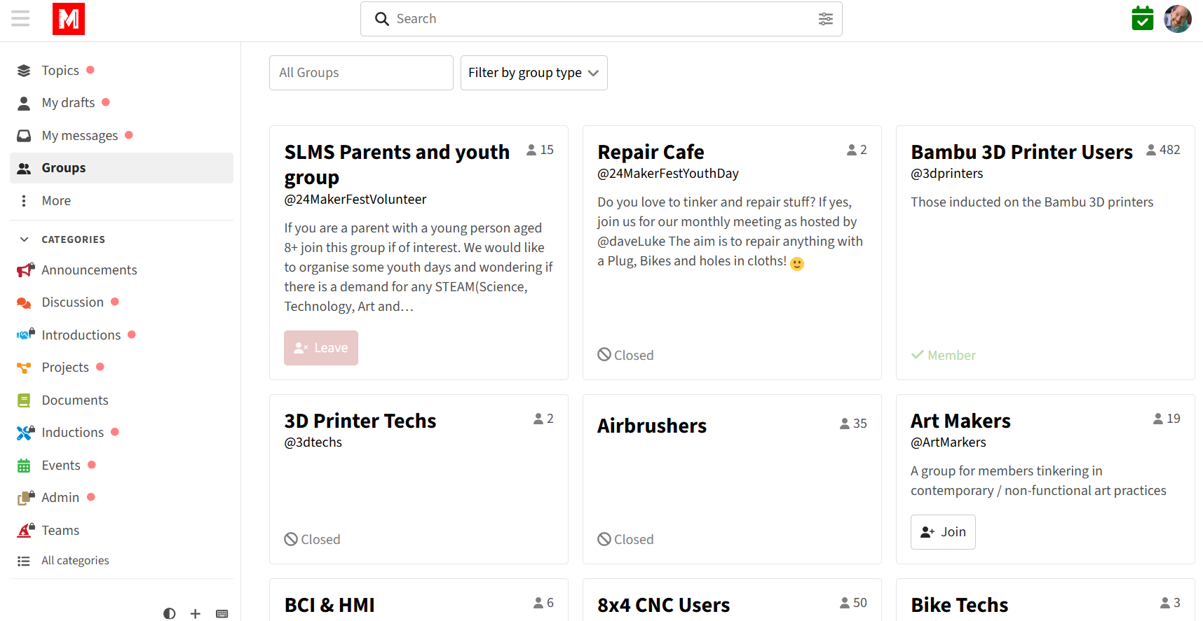
Finding groups
Groups include
  Tool users – e.g. @laserusers
  Techs – e.g. @lasertechs
  Interest groups – e.g. @video

Slide 20
Accessing the space

Slide 21
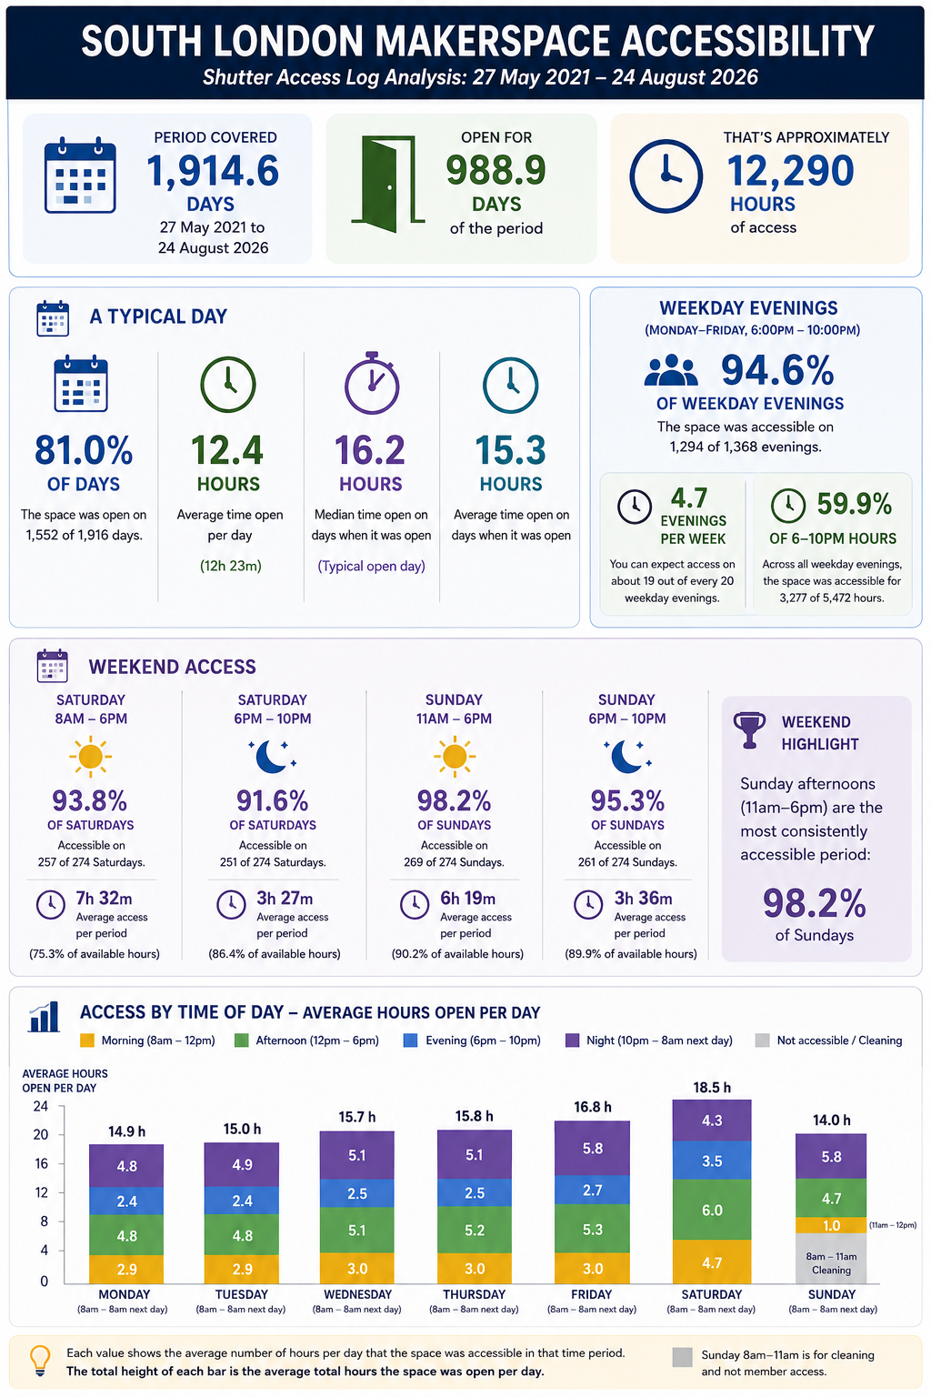
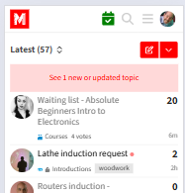
Access to the space
Shutter access holders open & close the shutter
Other members can only open the door
The space is open a lot!
Shutter open indicated by the
calendar icon colour

Slide 22
Access to the space
Closed for cleaning
  Arch 1 - Sundays 06:30 to 11:00
  Arch 2 - Mondays 07:00 to 10:00am
Parking permits
  2 permits
  Bookable
  Currently suspended due to arch refurbishment

Slide 23
Access to the space
Bringing guests
  Welcome
  Subject to the rules
  Can’t use the tools
Children
  Welcome
  Accompanied at all times
  Membership from 18 years
  Can’t use the tools

Slide 24
When there are no booking entries
Chances are that the space is open
The tool may be available, but you won’t be able to book it
When you get there, see if anyone who has shutter access is willing to make a space booking entry
Once they have, you can edit it and book the tool to secure your ongoing usea

Slide 25
Getting shutter access
Allows for access at any time
Comes with significant responsibilities
See the link in the slide notes for full details
Notes:
https://discourse.southlondonmakerspace.org/t/how-to-get-shutter-access/21084

Slide 26
Safety

Slide 27
Safety
Practices
  Inductions required
  Permitted uses and materials - see the Tools pages
  Lone working rule
Safety equipment
  Specified on the Tools page
  Bring your own
  Some provided - e.g safety goggles, hearing protection

Slide 28
Safety
Any chemicals need to have a COSHH assessment filled out and approved by a relevant area tech
No compressed, flammable gases
No working on (making or modifying) Lithium cell battery packs

Slide 29
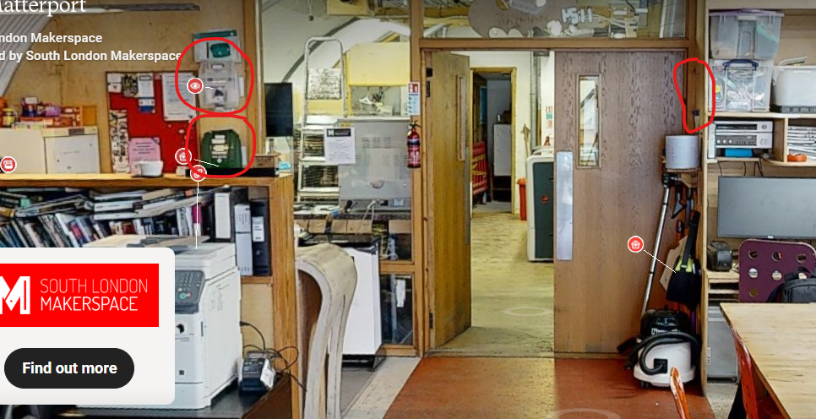
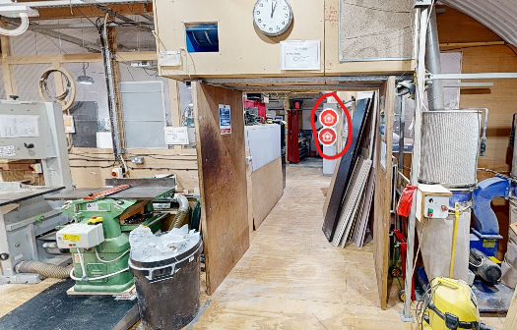
First aid
Clean room
  First Aid kit
  Eye wash kit
  Defibrillator
Metal area
  First Aid kit
  Trauma kit
Fire extinguishers all over

Slide 30
The tools

Slide 31
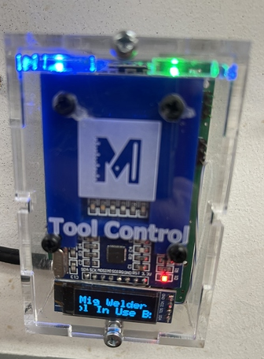
Tools Pages
List of tools on Discourse
Tools pages cover:
  Manuals
  Modifications
  Risk assessment and safe use
  Permitted uses and materials
Tool Control
  Inducted users tap with fob to activate a tool
Notes:
https://discourse.southlondonmakerspace.org/c/documents/tools/8

Slide 32
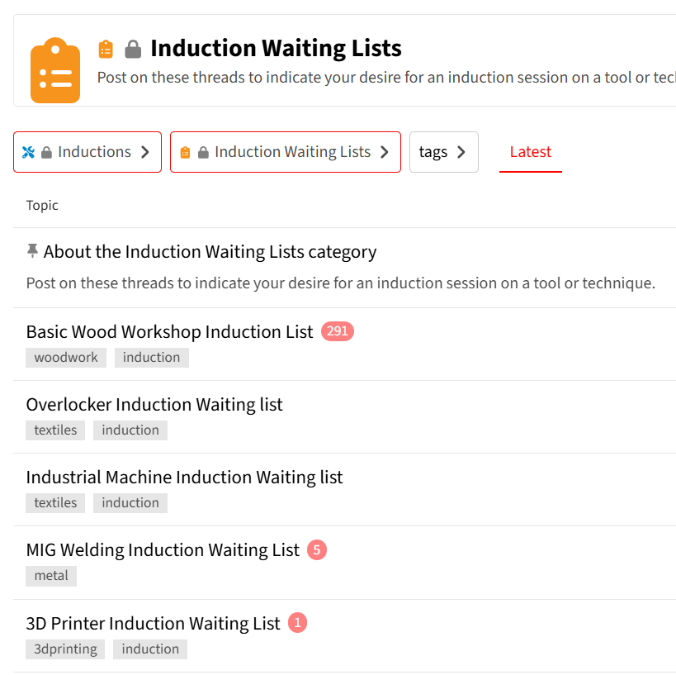
Inductions
Types of inductions
  Testing only vs teach and test
  Scheduled vs on-demand
Waiting lists
Invitations
  3-strike rule
Donations
Notes:
https://discourse.southlondonmakerspace.org/c/inductions/99

Slide 33
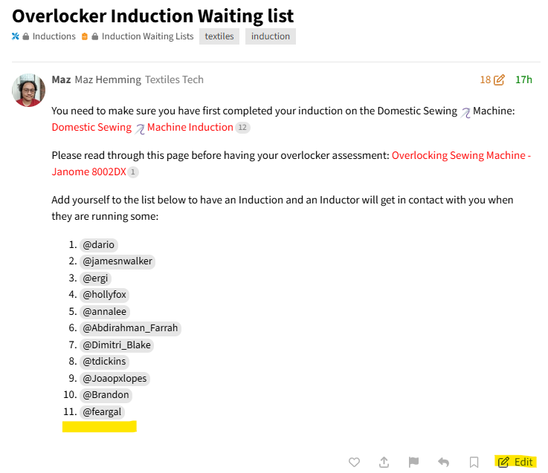
Adding yourself to an induction waiting list
Go to the waiting list page
Do NOT post a new message
Scroll to the bottom of the first post
Press the Edit button
Add your Discourse name to the list
When saved, make sure your name
is valid (appears in a grey box)

Slide 34
Materials
Materials in the space - laser, 3D printing, new clay
Paying for materials – login to main site required
Scrap materials - textiles, laser, recycled clay, wood
Supplier list
Deliveries to the space
  Timing and access
  Moving out of clean room
Notes:
https://discourse.southlondonmakerspace.org/t/suppliers-directory-where-to-get-parts-materials-and-services/2907

Slide 35
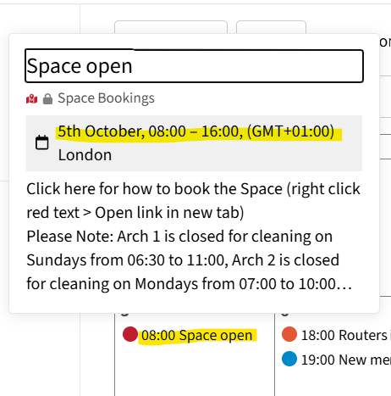
Booking a tool
If you don’t have shutter access
Find a suitable booking entry on the calendar
Click on the title
Click on the time in the popup
Press the edit button at the bottom of the post
Add your discourse name and times next to the tool
  If the space booking is for 11:00 – 14:00, do not book a tool from 11:00 to 15:00!

Slide 36
Tool restrictions and conditions
Some tools are very sensitive or easily broken
Tools should be used in the space to which they are assigned
Tools may not be borrowed or removed from the space
No personal power tools allowed

Slide 37
Getting help & support

Slide 38
Getting help & support
Be specific about the problem and the help you need — you’re asking for help, not handing over the project.
Contact techs – post, or private message
Ask for a Makerbuddy
Join a course
Post in projects category – what you’ve done or need help with
Attend a meetup - electronics, bike, metal
Tell the techs if you break something!
Notes:
https://discourse.southlondonmakerspace.org/t/makerbuddies/24367
https://discourse.southlondonmakerspace.org/t/courses-at-slms/47253/2
https://discourse.southlondonmakerspace.org/c/projects

